Slide 1
Calisthenics
Longitude and latitude are used to:
a. Tell the difference between cultures.
b. Locate places on a world map.
c. Navigate rivers.
d. Get from one highway to another.
Latitude is labeled:
a. North and East
b. West and South
c. North and South
d. East and West
Longitude goes from:
a. North to East
b. West to South
c. North to South
d. East to West

Slide 2
Political Map
A Political Map shows the boundaries and locations of political units.
Political units are communities that are united under a government.
Countries, states, counties, cities, and towns are political units. Many features depicted on a political map are made by humans.

Slide 3
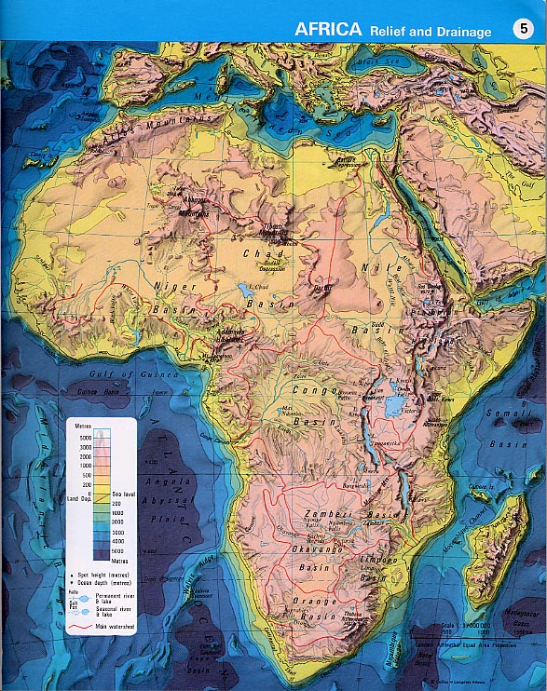
Physical Map
Physical Maps: A physical map shows the location and the topography, or shape, of the Earth’s geographic forms.
You use the SCALE to find the elevation.

Slide 4
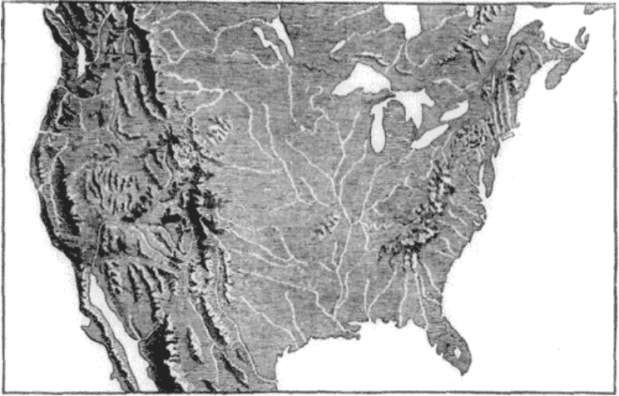
What makes this a physical map?

Slide 5
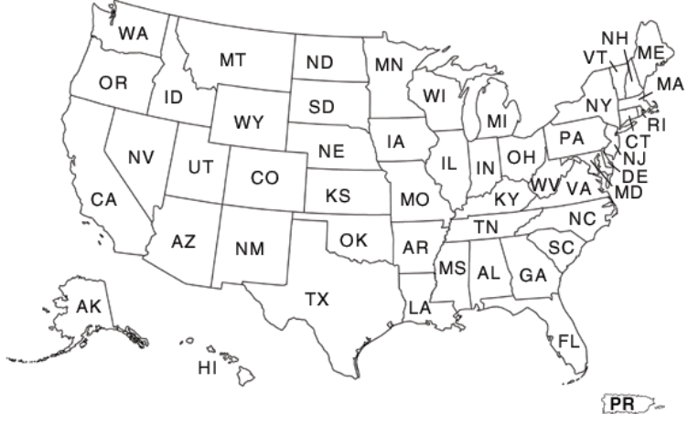
What makes this a political map?

Slide 6
How do you tell the difference!
How to tell the difference between a physical and political map:
Identify what the map is showing.
Ask: Is the main focus of the map made by humans or nature?
Made by humans? ➔ Political Map
Made by nature? ➔ Physical Map

Slide 7
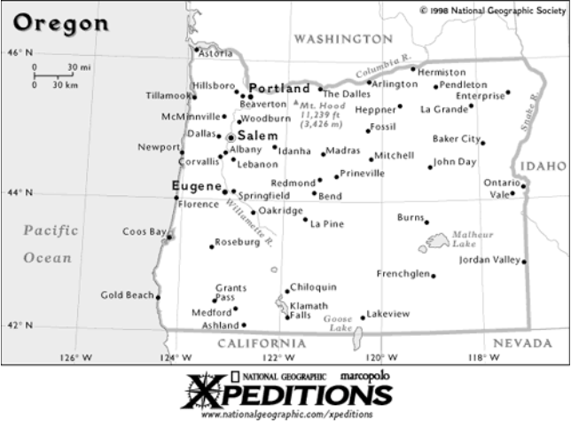
Political or Physical?

Slide 8
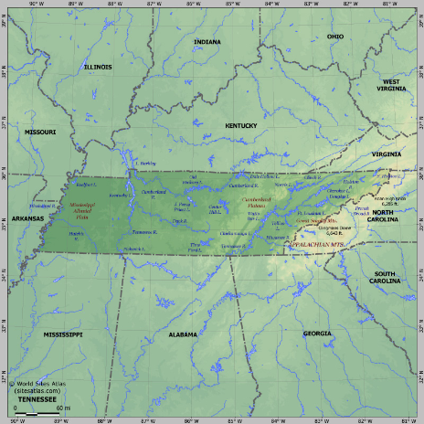
Political or Physical?

Slide 9
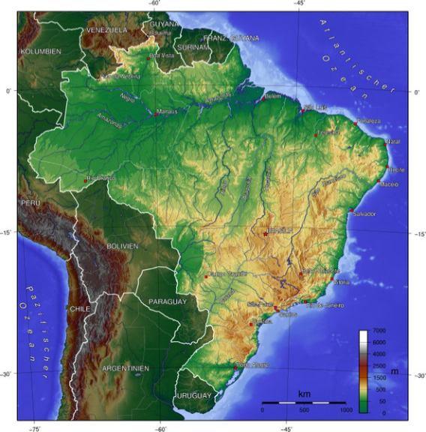
Political or Physical?

Slide 10
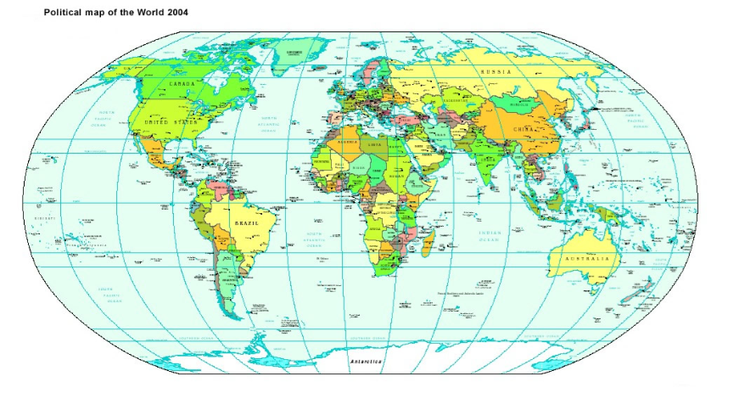
Political or Physical?

Slide 11
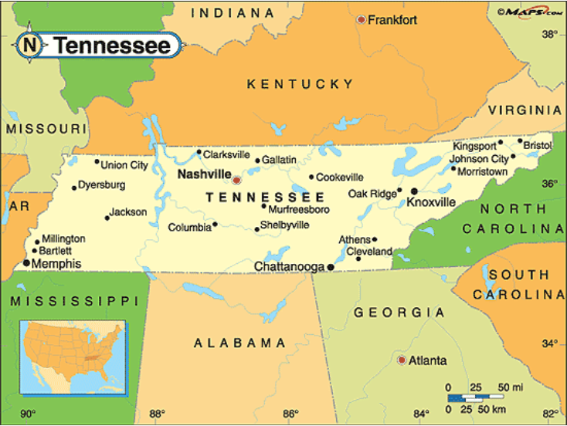
Political or Physical?

Slide 12
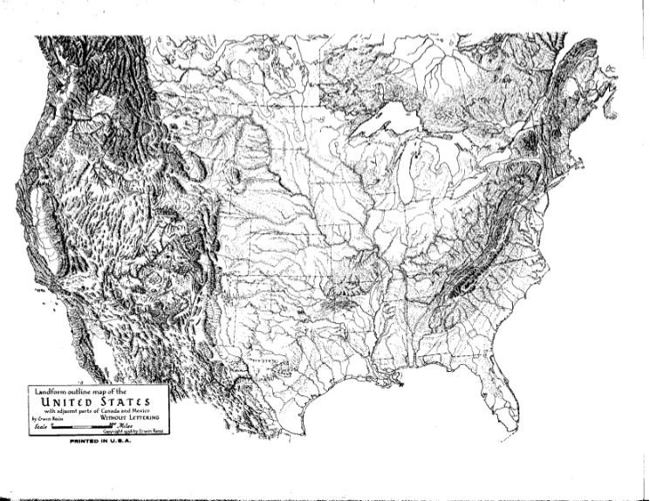
Political or Physical?

Slide 13
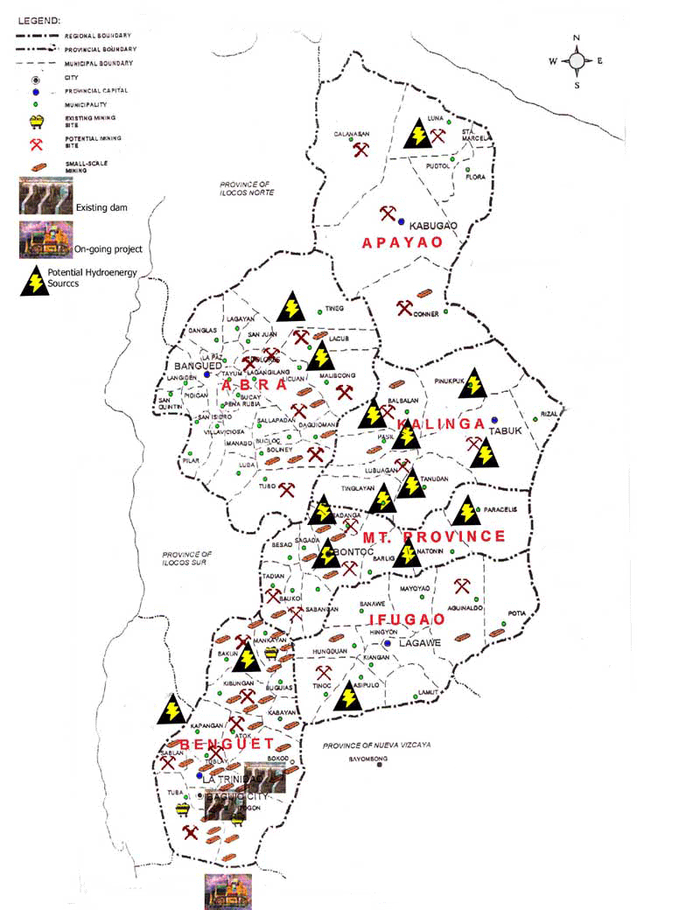
Resource Maps
Resource maps show the natural resources found in a region.
Use the map key to find the location of resources.

Slide 14
Topographic Map

Slide 15
Topographic Map
Two dimensional depiction of natural and human made features of the Earth
Used for hiking, resource management, and urban planning

Slide 16
Relief Map
Show contours of landmarks and terrain using colors rather than lines
More complex version of a topographical map

