Slide 1
How to use a MAP!
.

Slide 2
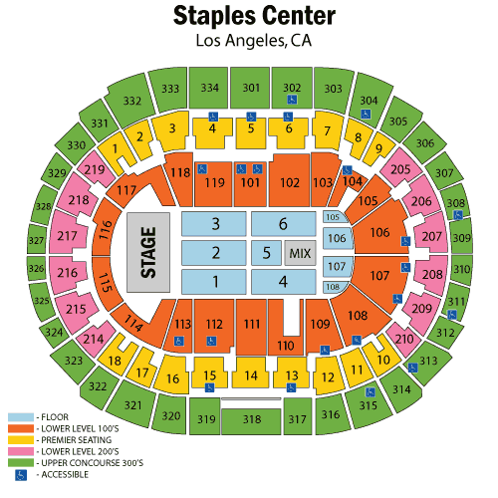
Title
Title: The title tells you what kind of information the map is showing.
Use the title of this map to answer the following question:
What does this map show?

Slide 3
There are 6 general types of maps
Political
Physical
Topographic
Climatic
Economic/Resource
Road

Slide 4
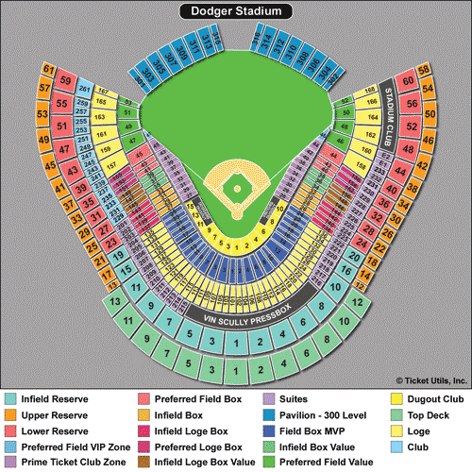
The Key or Legend
Key: The key lists and explains the symbols, colors, and lines used on the map. The key is sometimes called a legend.
Question #2: Can a brave student come up here and circle the KEY on our map.
Question 3: Use the legend on the map to answer the following question: Is section 35 on the upper reserve, loge, lower reserve, or pavilion?

Slide 6
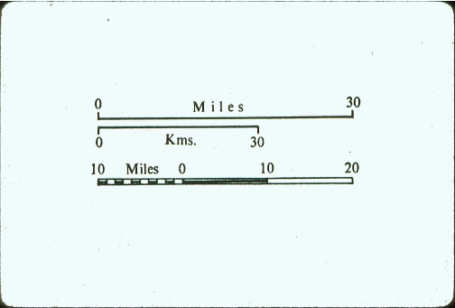
Scale
Scale: The scale shows the relationship between map measurements and actual distances on the earth. By laying a ruler along the scale, you can calculate how many miles or kilometers are represented per inch or centimeter.
Question #4: what measurement tool do you think we need to use in order to find the distance of things on a map?

Slide 7
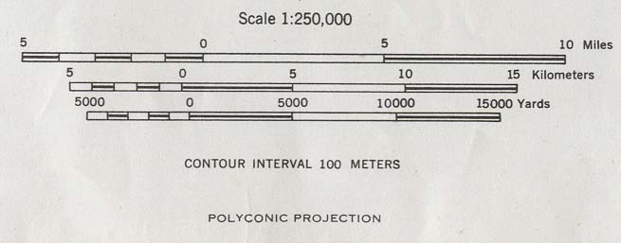
Question 5
What is the same between a scale that measures your weight and a scale on a map? What is different?

Slide 8
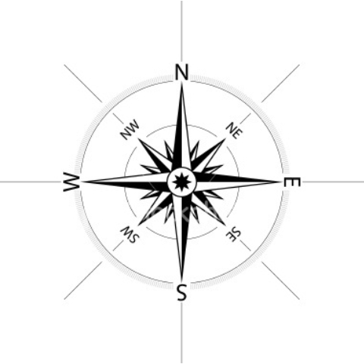
Compass Rose
Compass Rose: The compass rose shows directions.
The Cardinal Directions: north (N), south (S), east (E), and west (W).
The Ordinal Directions: northeast (NE), northwest (NW), southeast (SE), and southwest (SW).

Slide 9
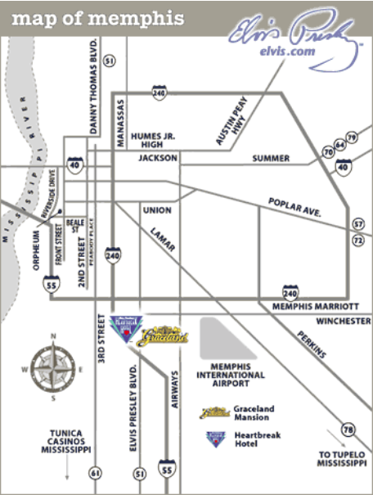
Question #4
Question 4: Use the compass rose and this map to answer. Which is farther north: Memphis International Airport or Heartbreak Hotel?
Step 1: Find both of the places.
Step 2: Draw a Compass Rose
Step 3: Solve!

Slide 10
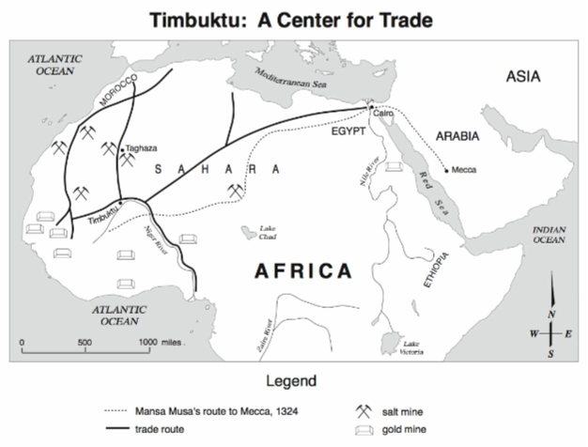
Question 7:
What part of the map tells you what the Map is about?
Question 8: Looking at the map, what is this map about?

Slide 11
What does this symbol represent?

Slide 12
How far is Timbuktu from Taghaza?
A. 500 miles
B. 2000 miles
C. 10 miles
D 5000 miles
What country is located in WEST Africa?
A. Egypt, B. Ethiopia, C. Arabia, D. Morocco

Slide 13
Make an inference:
What goods were traded in Timbuktu?

