Slide 2
locate lines of longitude and latitude and use them to locate points on a world map.

Slide 3
What is Latitude?
Lines of latitude run from WEST to EAST and are labeled NORTH and SOUTH.
LAT IS FLAT

Slide 4
The Equator Is a Line of Latitude!
Equator:
The equator is the line of Latitude at 0°.

Slide 5
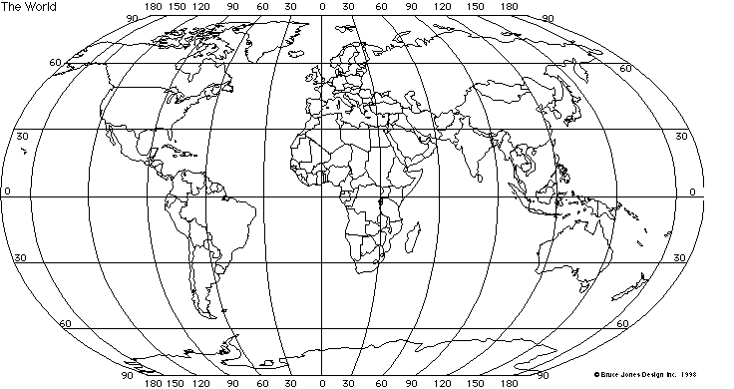
60° North
30° North
B
A
Equator
60° South
C

Slide 6
What is Longitude?
Lines of longitude run from WEST to EAST and are labeled NORTH and SOUTH.

Slide 7
The Prime Meridian is a Line of Longitude!
Prime Meridian:
The prime meridian is the line of Longitude at 0°.

Slide 8
Prime Meridian
120° West
A
B
90° East

Slide 10
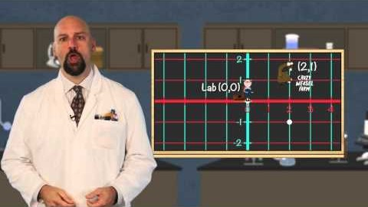

Slide 11
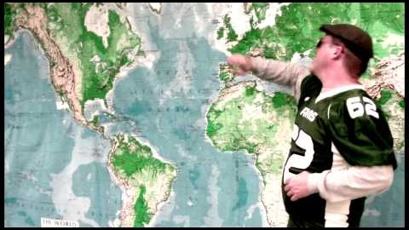

Slide 12
In groups of 3 you are going to plot each other’s birthdays on the map

Slide 13
FANTASY DESTINATION
Look up your fantasy location
Write one paragraph explaining why you want to go there
Indicate starting location and end location on a map (created or found online)
Included in the map must be the latitude and longitude of both your starting location and end location

